Slide 1
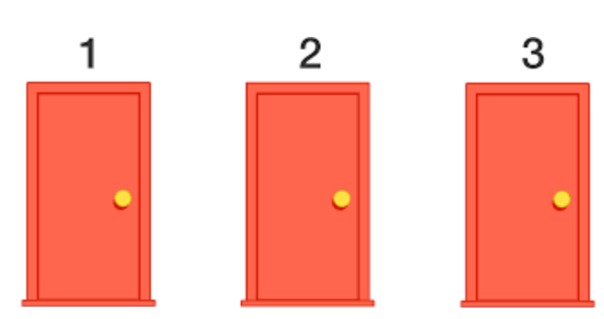


The Monty Hall Problem

Slide 2
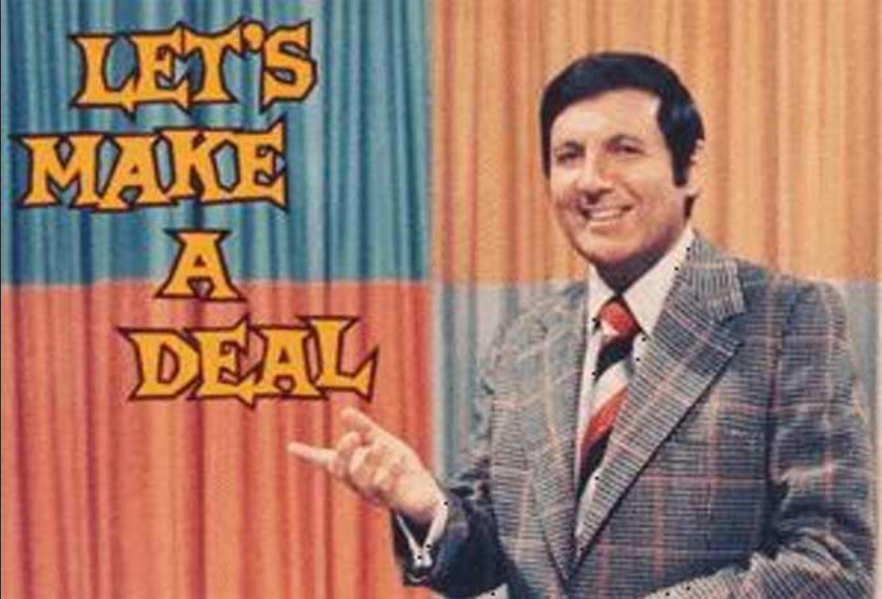
The Monty Hall Show 1963-1968
Suppose you're on a game show, and you're given the choice of three doors: Behind one door is a car; behind the others, goats. You pick a door, say No. 1, and the host, who knows what's behind the doors, opens another door, say No. 3, which has a goat. He then says to you, "Do you want to pick door No. 2?" Is it to your advantage to switch your choice?

Slide 3
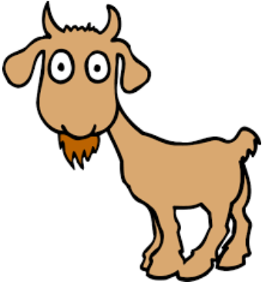

1
2
3
Stay
Stay
Switch
Switch
Stay
Switch
Remove one door
Remove one door
Remove one door

Slide 4
1
2
3
Stay
Switch
Stay
Switch
Stay
Switch
Remove one door
Remove one door
Remove one door

Slide 5
1
2
3
Stay
Stay
Switch
Stay
Switch
Switch
Remove one door
Remove one door
Remove one door

Slide 6
1
2
3
Stay
Stay
Switch
Switch
Switch
Stay
Remove one door
Remove one door
Remove one door

Slide 7
1
2
3
Stay
Switch
Stay
Switch
Switch
Stay
Remove one door
Remove one door
Remove one door

Slide 8
1
2
3
Stay
Stay
Switch
Stay
Switch
Switch
Remove one door
Remove one door
Remove one door

Slide 9
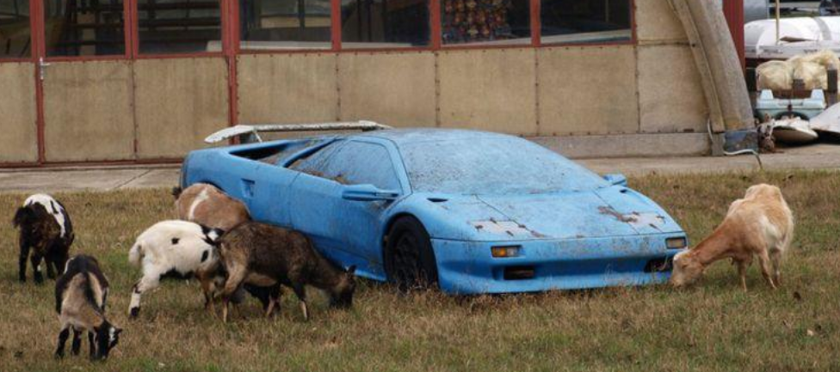

Slide 10
Is it better to Stay or Switch?
Create a tree diagram
There are 6 outcomes and the only thing we can control at the end is “staying” or “switching”
Switch
Switch
Stay
Switch
Stay
Stay
2
4
5
The probability of winning a car is twice as likely if we switch
1
3
6

